Slide 1
Introduction to Software Reversing
CS-577-A, Fall 2021
Jun Xu
Credits of slides belong to Yan Shoshitaishvili
-- https://pwn.college/modules-old/reversing

Slide 2

The Forward Engineering Process
Design
Code
"Forward Engineering" is an overloaded term, but in this context, it is the process of building a program.
Figure out what you want to code.
Code it.
Compile it (can include JIT).
Run it.
At every step, information is lost!
Compile
Fix Tons of Bugs
Compile
Extensive Cursing
Fix More Bugs
Compile
Assemble

Slide 3
Discussion
Design
Code
What is lost in the transition between Design and Code?
Compile
Fix Tons of Bugs
Compile
Extensive Cursing
Fix More Bugs
Compile
Assemble

Slide 4
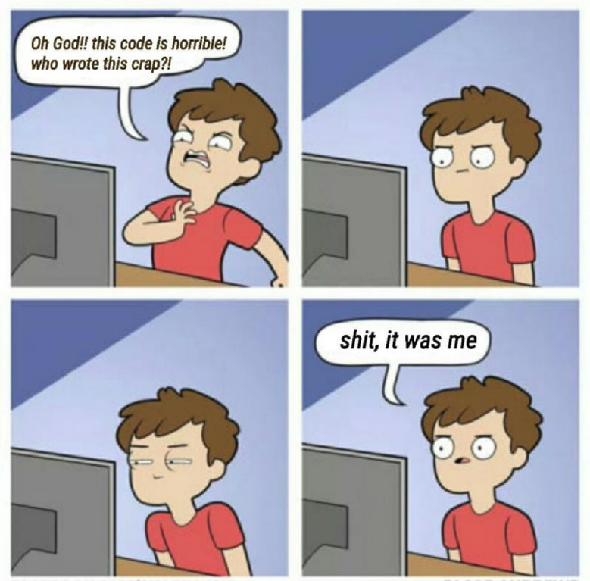
Discussion
Design
Code
What is lost in the transition between Design and Code?
Compile
Fix Tons of Bugs
Compile
Extensive Cursing
Fix More Bugs
Compile
Assemble

Slide 5
Discussion
Design
Code
What is lost in the compilation process?
Comments
Variable names.
Function names.
Structure (classes, structs, etc) data.
Sometimes, entire algorithms (optimization)!
How do we get it back?
Compile
Fix Tons of Bugs
Compile
Extensive Cursing
Fix More Bugs
Compile
Assemble

Slide 6
Forward Engineering Tools
Design
Code
Let's look at some tools:
Your IDE (we will not look at this).
The GNU C Compiler.
The GNU Assembler.
other assemblers
The GNU Linker.
Viola! An ELF is born.
Compile
Fix Tons of Bugs
Compile
Extensive Cursing
Fix More Bugs
Compile
Assemble

Slide 7
The Reverse Engineering Process
Design
Every step in the reverse-engineering process is imperfect and relies on some amount of human help.
The focus of this class: how do we reverse the design from the binary?
Available tools:
many disassemblers (we'll look at objdump)
some decompilers (the good ones are $$$$$$)
debuggers (gdb)
simple program analysis tools (ltrace, strace)
heavyweight program analysis tools
Lots of Thinking
Decompile
Disassemble

Slide 8
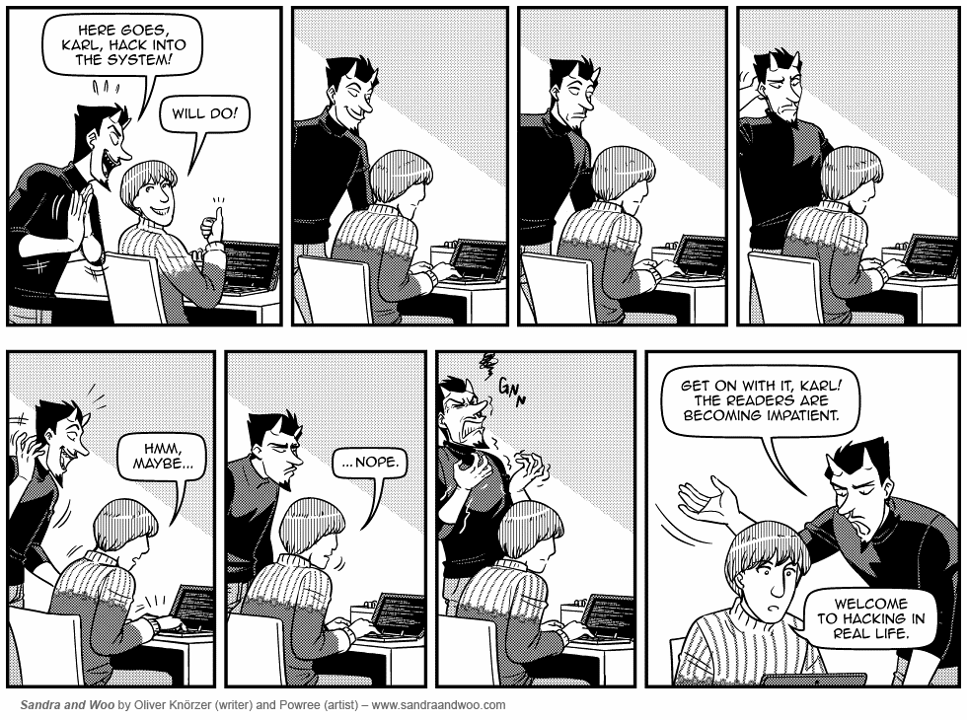
The Reverse Engineering Process
Design
Every step in the reverse-engineering process is imperfect and relies on some amount of human help.
The focus of this class: how do we reverse the design from the binary?
Available tools:
many disassemblers
some decompilers (the good ones are $$$$$$)
debuggers (gdb)
simple program analysis tools (ltrace, strace)
heavyweight program analysis tools
Lots of Thinking
Decompile
Disassemble

Slide 9
Reverse Engineering - Simple Example
Design
Crackmes are small programs designed to test a hacker's reverse engineering skillz.
Inspired by real-world license key verification systems.
Lots of Thinking
Decompile
Disassemble
Crackme: https://en.wikipedia.org/wiki/Crackme
Many many crackmes: https://crackmes.one

Slide 10
License Checkers
Back in the stone age, before every cave had internet access, software had to be installable without internet access.
How does the software ensure that it is legitimate?
License key checks!
Have a secret algorithm that takes in input, performs some calculation, and validates the result.
Ideally, the company selling the software can generate multiple valid keys.
Ideally, pirates cannot generate valid keys.
This method implicitly trusts the binary code to keep the secret license key verification algorithm safe!

Slide 11
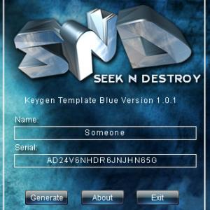
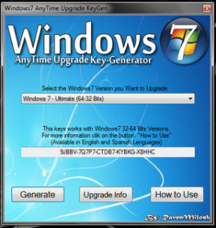
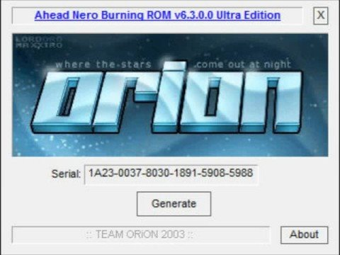
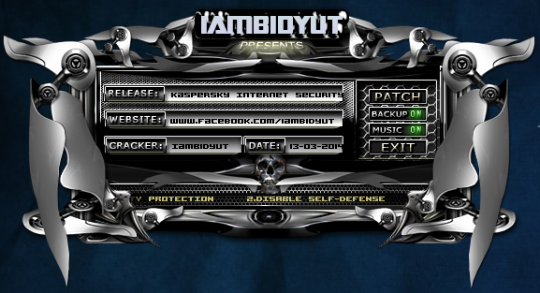
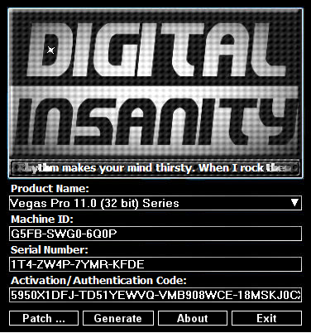
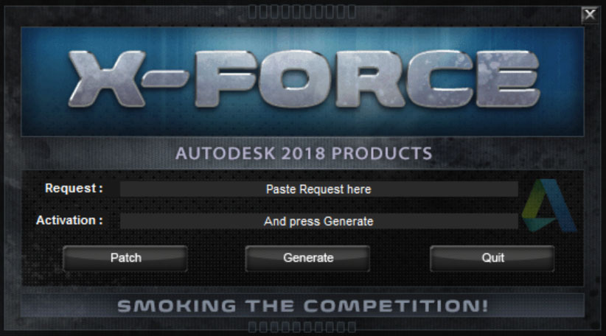
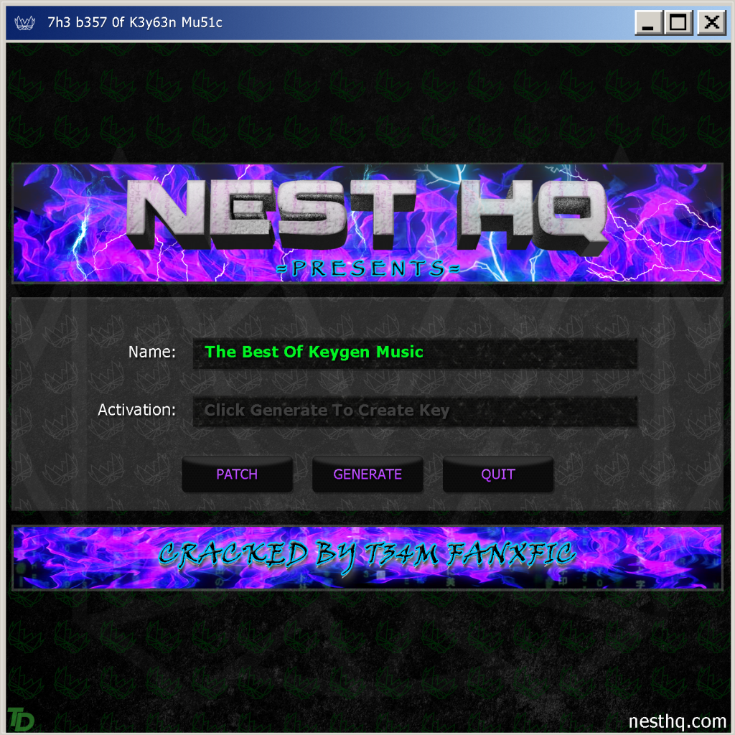
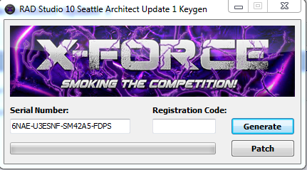
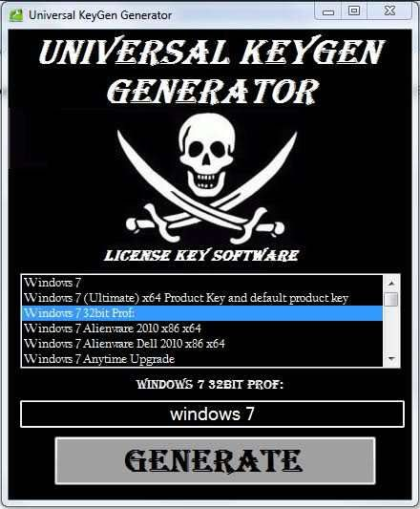
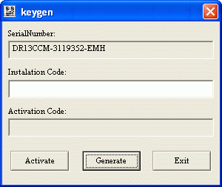
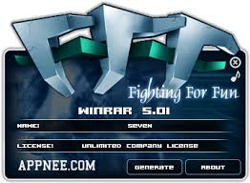
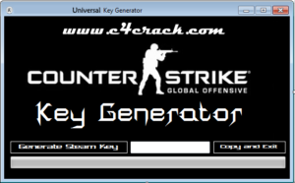
The Rise of Keygens

Slide 12

The Rise of Keygens

Slide 13
Alternatives to Keygens
Cracks that patch the executable to remove the check altogether.
Legally purchasing the software.
With ubiquitous internet access (and increased ability to have unbreakable server-side license key checks), keygenning diminished in viability.

Slide 14
Useful Reversing Tools (and demo)
For simple crackmes, ltrace might be sufficient!
more info than strace, but still not enough for anything complex
Running the program with multiple different inputs might get you farther.
ltrace it with input A
ltrace it again with input B
see if you can reverse the algorithm from looking at input and output
still does not scale to complex algorithms
Others:
gdb (and gdb scripting!)
The authority on gdb: https://sourceware.org/gdb/onlinedocs/gdb/
objdump
ghidra (https://ghidra-sre.org)

Slide 15
Useful Reversing Tools (advanced)
There are some advanced, experimental research tools that can be used for reverse engineering:
angr
advanced program analysis suite that lends itself quite nicely to crackmes
hard to install (though there is a docker image!), and hard to use
you'll probably have to understand how to solve things manually before you can angr them
Dynamic analysis tools:
https://github.com/zardus/ctf-tools has helpful install scripts for tools
taintgrind will tell you what the program is doing with your input
again: gdb scripting!

Slide 16
